Slide 1

Automatic Street Lighting using LDR
Group members:
Sooraj Prasad (34900319042)
Soumojit Bakshi (34900319012)
Snehasish Pradhan (34900319049)
Shubhamay Sarkar (34900319027)
Soumya Barik (34900319035)
Semester: VI
Dept: Electronics and Communication Engineering

Slide 2
Acknowledgement
A project of this enormity depends on a large number of people for its success. So, we take this opportunity to thank the people who guided us in this project.
We are thankful to our institution, Cooch Behar Government Engineering College for providing us with the opportunity to conduct the research behind this project. We express our sincere and deep gratitude to Dr. Prabal Deb, Principal of Cooch Behar Government Engineering College, for giving us the privilege to research and make a successful project on ‘Automatic Street Lighting using LDR’, as a part of our Bachelor of Technology Semester VI curriculum.
We would also like to take this opportunity and express our sincere gratitude to our supervisor and guide, Dr. Palash Das for lending a helping hand and guiding us throughout this project and this would not have been possible without him.
Lastly, we would like to thank our parents for their utmost guidance throughout.

Slide 3



9V Battery
Battery Connector
BC-547 Transistor
Components Required
100 kilo ohm, 1 kilo ohm and 100 ohm resistor
LDR
Wire
LED

Slide 4

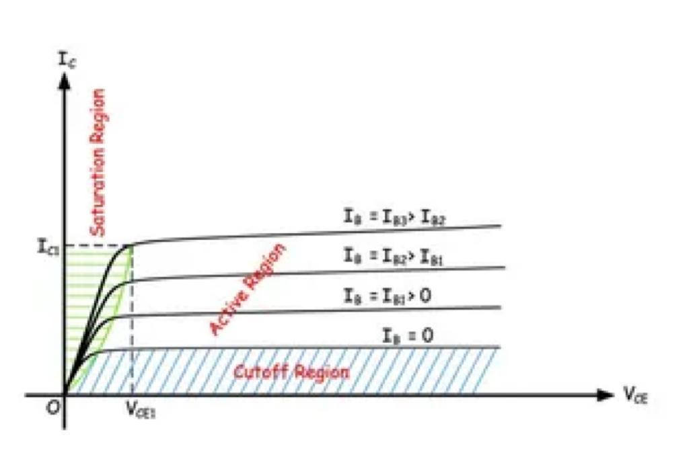
Working Principle of BJT as a Switch
A switch offers open circuit (infinite resistance) when it is put in ‘OFF’ position and offers short circuit (zero resistance) when it is put in ‘ON’ position. Similarly in a bipolar junction transistor, by controlling base-emitter current, the emitter-collector resistance can be made either nearly infinite or nearly zero.
In a transistor characteristic, there are three regions. They are
Cutoff Region
Active Region
Saturation Region
In the active region, for wide range of collector-emitter voltage (VCE) collector current (IC) remains constant. As the voltage has a wide range and collector current is almost constant, there will be significant power loss if the transistor is operated in this region. When an ideal switch is OFF, the current is zero hence there is no power loss.
Similarly, when the switch is ON, the voltage across the switch is zero hence, there is no power loss again. When we want a BJT to be operated as a switch, it must be operated in such a way that the power loss during ON and OFF condition should be nearly zero, or very low.

Slide 5
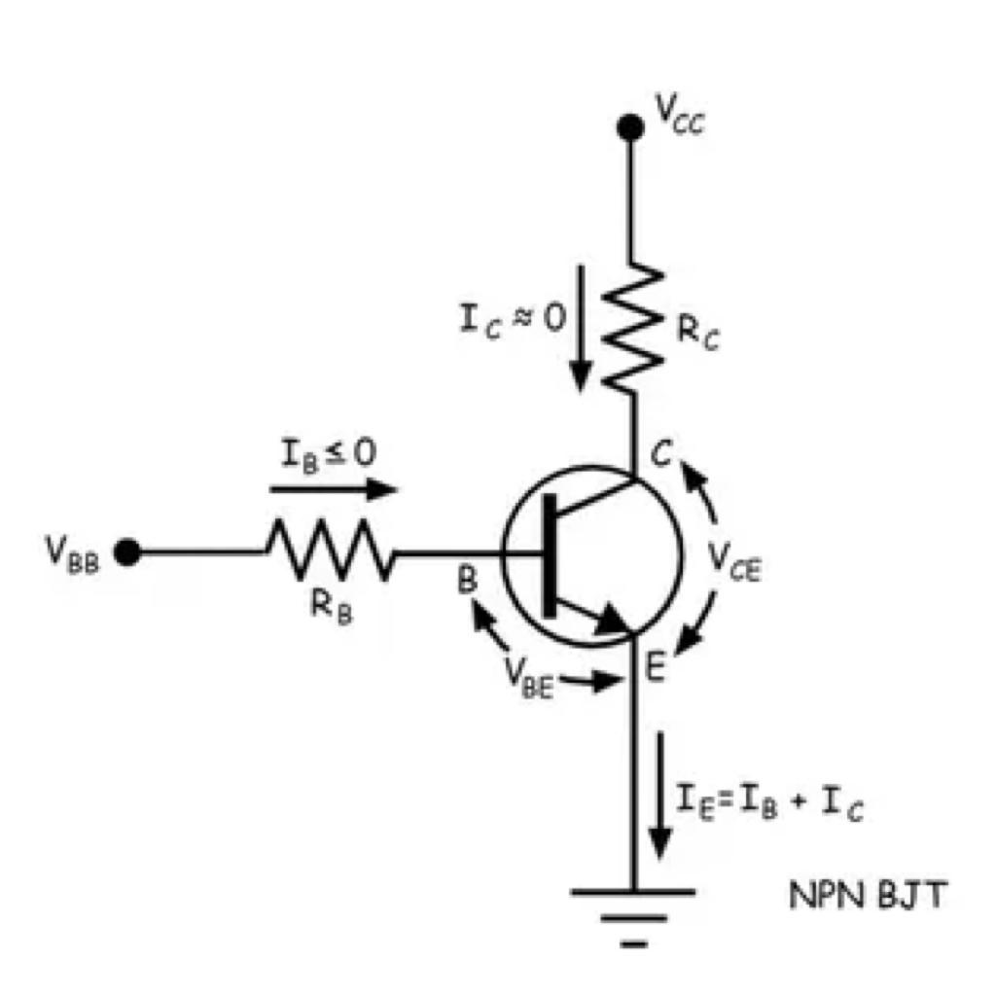
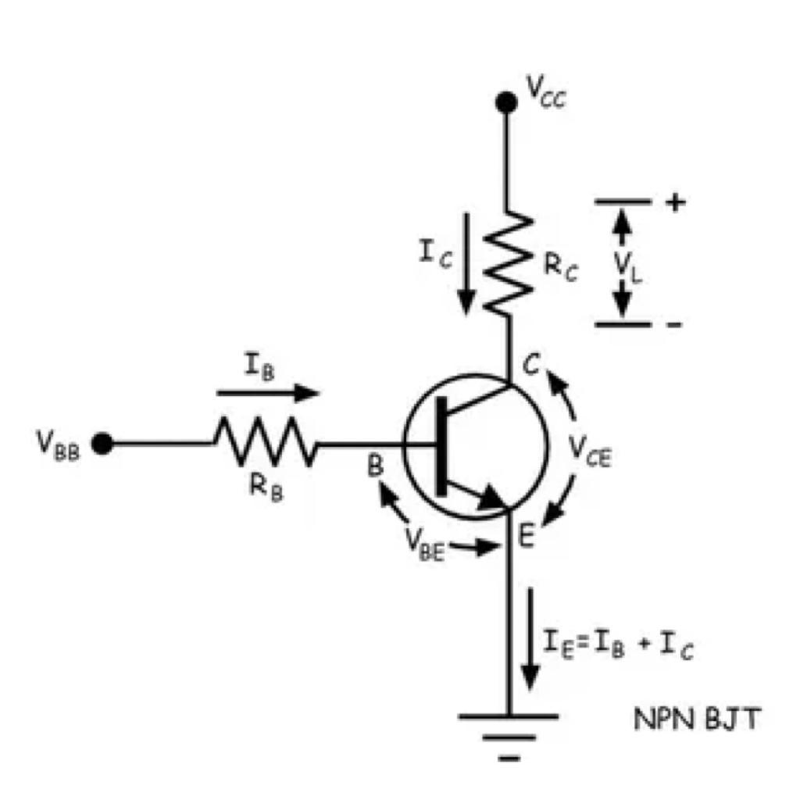
Working Principle of BJT as a Switch (contd.)
It is only possible when the transistor is only operated in the marginal region of the characteristics. The cutoff region and saturation region are two marginal regions in the transistor characteristics. Note that this applies to both npn transistors and pnp transistors.
In the figure, when base current is zero, the collector current (IC) has very small constant value for a wide range of collector-emitter voltage (VCE). So when the transistor is operated with base current ≤ 0, the collector current (IC ≈ 0) is very tiny, hence the transistor is said to be in OFF condition but at the same time, power loss across the transistor switch i.e. IC × VCE is negligible because of very tiny IC.
If the transistor is operated with a base current IB3 for which collector current is IC1. IC is less than IC1, then the transistor is operated in the saturation region. Here, for any collector current less than IC1, there will be very tiny collector-emitter voltage (VCE < VCE1). Hence in this situation, the current through the transistor is as high as load current, but the voltage across the transistor (VCE < VCE1) quite low, hence power loss in the transistor is negligible.
The transistor behaves as an ON switch. So for using the transistor as a switch we should make sure that the applied base current must be sufficiently high to keep the transistor in the saturation region, for a collector current.

Slide 6
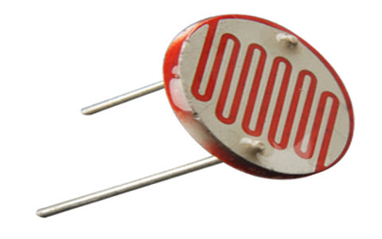
WORKING PRINCIPLE OF LIGHT DETECTING RESISTOR (LDR)
An electronic component like LDR or light-dependent resistor is responsive to light. Once light rays drop on it, then immediately the resistance will be changed. The resistance values of an LDR may change over several orders of magnitude. The resistance value will be dropped when the light level increases.
The resistance values of LDR in darkness are several megaohms whereas in bright light it will be dropped
The designing of LDRs can be done by using semiconductor materials to allow their light-sensitive properties. The famous material used in this resistor is CdS (cadmium sulfide), even though the utilization of this material is currently restricted in European countries due to some environmental issues while using this material. Likewise, CdSe (cadmium selenide) is also restricted and additional materials that can be employed mainly include PbS (lead sulfide), InS ( indium antimonide).

Slide 7
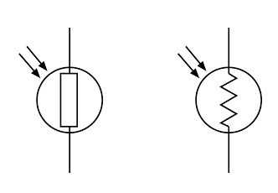
WORKING PRINCIPLE OF LIGHT DETECTING RESISTOR (LDR) (contd.)
Even though for these resistors, a semiconductor material is used, because they are simply passive devices and they do not have a PN-junction. This detaches them from other LDRs such as phototransistors & photodiodes.
The working principle of an LDR is photoconductivity, which is nothing but an optical phenomenon. When the light is absorbed by the material then the conductivity of the material enhances. When the light falls on the LDR, then the electrons in the valence band of the material are eager to the conduction band. But, the photons in the incident light must have energy superior to the bandgap of the material to make the electrons jump from one band to another band (valance to conduction).
Hence, when light having ample energy, more electrons are excited to the conduction band which grades in a large number of charge carriers. When the effect of this process and the flow of the current starts flowing more, the resistance of the device decreases

Slide 8

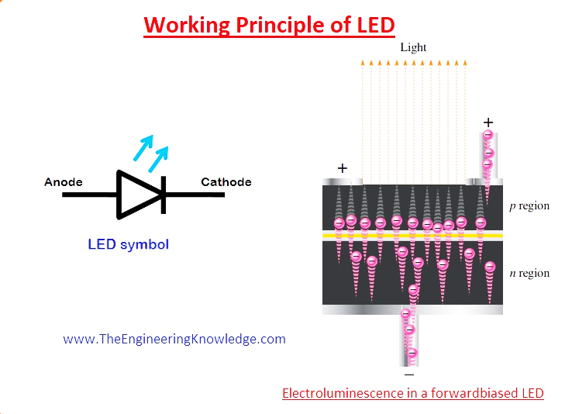
WORKING PRINCIPLE OF LED

Slide 9
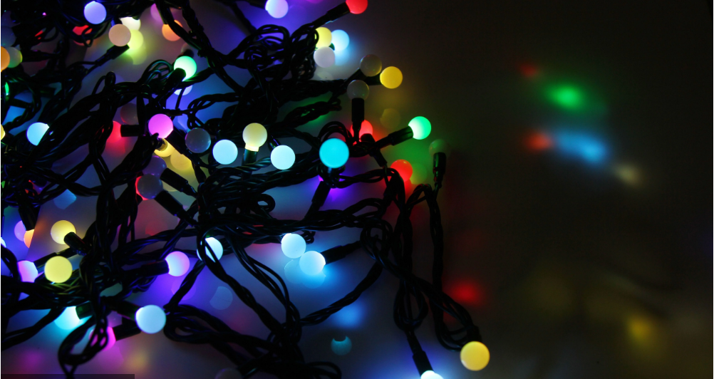
The LED stands for light-emitting diode.
The working of LED is very simple when led is in forward biasing conditions the electrons existing in N side of diode cross the PN junction and enter in the P region combine with the holes existing in that region and emit light.
There are two main bands of energy first one is the conduction band that has a large number of electrons, in this case, is N region.
Second is a valance band that is P region of diode and has holes in it. So when electrons move from high conduction band to valance band or combine with the holes releases energy in the form of light.
The type of light emitted depends on the type of bandgap and other related parameters.
A large visible area on a single sheet of the semiconductor substance allows the photons to be released as visible light.
This procedure is known as electroluminescence and described in the below picture.
For maintaining the wavelength of light emitted numerous materials are added during the process. The colour of visible light relies on the wavelength emitted.
There are some light-emitting diodes that release lights which not found in a spectrum of visible light but their wavelength is longer and exits in the infrared region of the spectrum.

Slide 10
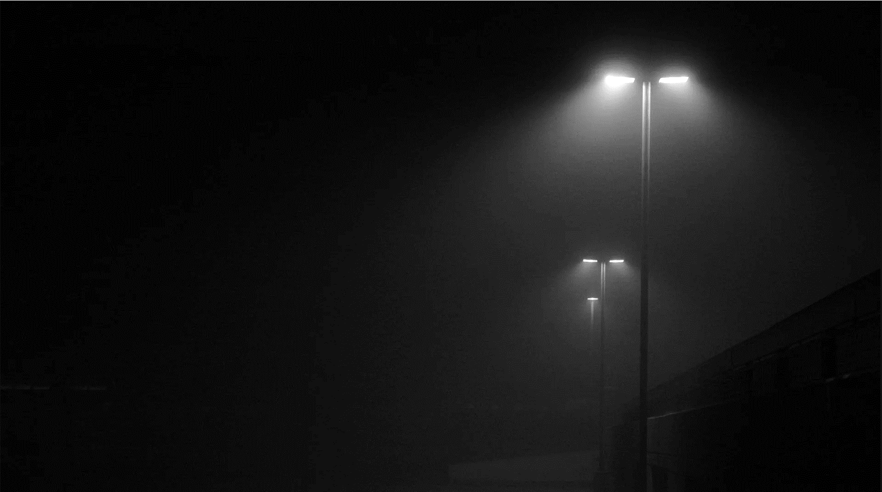
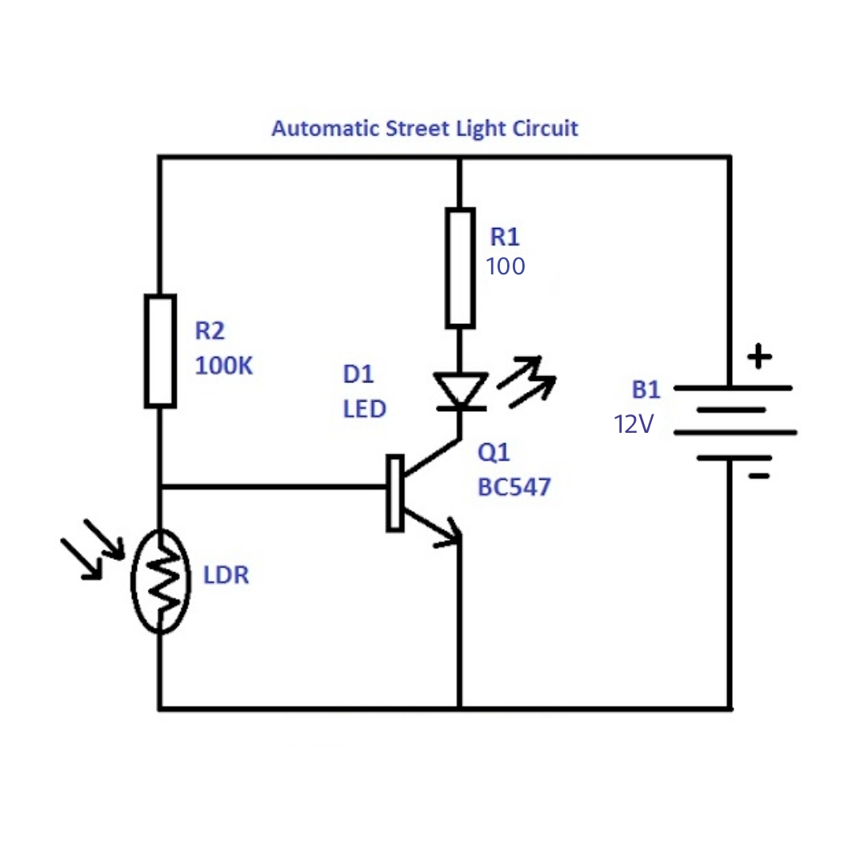
Circuit Diagram of an Automatic Street Light and its Working Principle
The circuit diagram of a LDR is shown below. When the light intensity is low, then the resistance of the LDR is high. This increases the current flow to the base terminal of the transistor which also increases the current flowing through the led in the collector terminal.
Due to the current flow, BJT acts in the ON condition and the LED gets forward biased and lights up. However, when the light intensity onto the LDR is high, then the resistance of the LDR is low so current less amount of current flows through the base terminal and majority flows through the LDR thereby reducing the current flow in the collector terminal and the BJT works in the off condition. Consequently the LED do not turn on.

Slide 11

Photo resistors are applied, most of which involve recognizing the presence of light
Strobe (colour
temperature reading)
Camera (electronic shutter)
APPLICATIONS
Used in Digital cameras to perceive how much light camera sees and adjust the picture quality accordingly
Used in some clocks, alarms and other electronic devices that are semi-dependent on sunlight
Burglar alarm systems
Smoke detection
Automatic lighting
control

Slide 12
Unable to detect low light levels and may take a few seconds to deliver a charge while their electrons build up momentum
Batteries of the automatic street light system are required to be replaced a few times
Is sensitive to ambient light and require careful shielding
DISADVANTAGES
Generation of energy for solar street light entirely depends on climatic conditions
Automatic street light system requires a higher investment in comparison to conventional street lights.
Risk of theft of the automatic street light system is relatively higher since they are non-wired and are expensive

Slide 13


